Slide 1
EduAssess360 AI based Exam and Preparation
Project by Nahidul Islam Shakin
Id : 18CSE246
Project Supervisor
Sakifa Aktar
Assistant Professor,
CSE, BSMRSTU

Slide 2
Welcome to my presentation

Slide 3
INTRODUCTION
Common Challenges in Exam Preparation :
Lack of personalized feedback and analysis after exams.
Difficulty in finding relevant syllabus, guides and notes.
Inefficient time management due to scattered study resources.
Overwhelmed by the abundance of information.
Limited access to effective practice exams.

Slide 4
INTRODUCTION
EduAssess360 Solution :
Integrated platform providing syllabus, notes.
Personalized study recommendations.
AI-driven insights to identify and improve weak areas.
Streamlined access to category-wise exams and tailored study materials.

Slide 5
KEY FEATURES
MCQ and Written Exams : Exams with AI evaluation and feedback.
Category-Wise Exam System : Different levels like SSC, HSC, Undergraduate, Job exam.
AI-Driven Notes and Suggestions : Personalized content based on exam performance.
Reward System : Points for good performance, which can be converted to unlock paid features.
Subscription System : Paid exams, notes, and other resources.
Teacher Panel : Allows teachers to set questions, get feedback, and improve question quality.
Admin Panel : Controls question permissions, point distribution, and more.

Slide 6
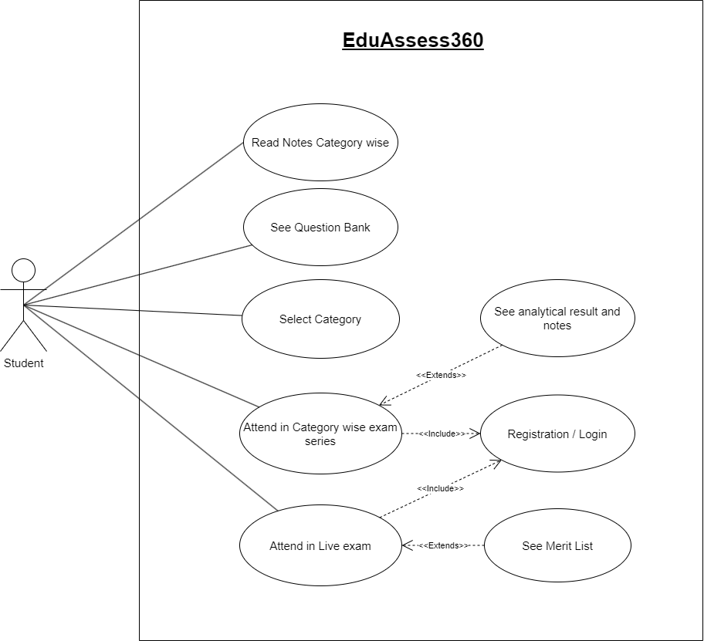
User Panel Use Case Diagram

Slide 7
Key Actions in the User Panel
Read Notes Category-Wise
Access study notes organized by specific exam categories.
See Question Bank
Browse and practice with a comprehensive question bank.
Select Category
Choose the exam category for targeted content.
Attend in Category-Wise Exam Series
Participate in a series of practice exams tailored to your category.

Slide 8
Key Actions in the User Panel
Attend in Live Exam
Take real-time, live exams to simulate the actual test environment.
See Analytical Result and Notes
Get detailed performance analysis and study recommendations.
See Merit List
View rankings and compare performance with peers.
Registration/Login
Register or log in to access personalized features.

Slide 9
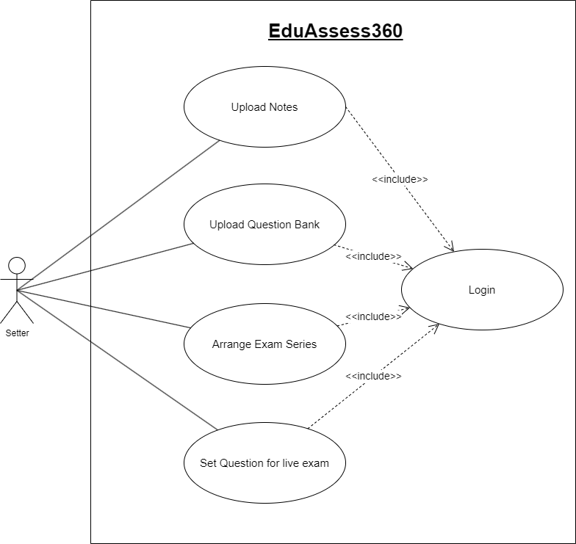
Setter Panel Use Case Diagram

Slide 10
Key Actions in the Admin Panel
Upload Notes
Add study notes to the system, categorized by exam type.
Upload Question Bank
Manage and upload questions for various exams.
Arrange Exam Series
Organize and schedule category-wise exam series.
Set Questions for Live Exam
Select and set questions for upcoming live exams.
Login
Secure access to the admin panel for authorized users.

Slide 11
Project Implementation
Cross-Platform Development :
The app is built for both Android and iOS, with admin and question setter panels designed for Windows.
Technology Stack :
Front-End : Flutter (Dart Language) for developing a responsive and cross-platform user interface.
Back-End Django to handle server-side logic and API management.
Database: MySQL for managing and storing user data, exam questions, and results.

Slide 12
Project Implementation
Architecture :
Utilizes the MVVM (Model-View-ViewModel) architecture for scalable and maintainable codebase.
Deployment :
Android and iOS apps will be deployed to their respective app stores.
Admin and question setter panels will be deployed for windows OS.

Slide 13
Development Workflow
Requirement Gathering & Analysis
Define features and technical requirements.
Design Phase
UI/UX design, database schema, and architectural planning.
Front-End Development
Build UI using Flutter, implement state management.
Back-End Development
Develop APIs with Django; connect to MySQL database.
Testing & Debugging
Conduct unit, integration, and user acceptance testing.
Deployment
Release on app stores; deploy admin panel on Windows.
Maintenance & Updates
Monitor, fix bugs, and update features regularly.

Slide 14
Conclusion
EduAssess360 addresses key challenges in exam preparation by providing a comprehensive, AI-driven solution.
The app enhances the learning experience with personalized feedback, targeted study materials, and structured exam practice.
Cross-platform implementation ensures accessibility for students on both Android and iOS, with robust support through admin and teacher panels.
Future updates will focus on expanding features and improving the user experience.

